Slide 1



KRAF THINK 2025 HACKATHON
Empowering innovation, fostering collaboration, and transforming ideas into reality – join the Kraf Think 2025 Hackathon revolution!
Team Name : Quantum
Team Leader Name : Ayush Mahanta
Team Members Name : Nikhil Kumar Singh
Sejal Kumari
Aditya Singh

Slide 2
Table of contents
01
04
02
05
03
06
Cover Slide
Scheduling
Content creation
Format and design
Review and editing
Final review

Slide 3
01
Cover Letter

Slide 4
Cover Letter
Quantum – Ayush Mahanta , Nikhil Kumar Singh , Sejal Kumari , Aditya Singh
Kraf Think 2025
24-02-2025

Slide 5
02
Problem Statement

Slide 6
Problem Statement
Problem: 1. Students struggle with overspending, lack budgeting tools, and face financial stress.
Importance: 1. 78% of students report financial anxiety due to poor expense management (example stat).
2. No centralized platform for student discounts + expense tracking.
Social Impact: 1. Promotes financial literacy and reduces debt.

Slide 7
03
Solution Overview

Slide 8
Solution Overview
AI-driven app for expense tracking, predictive budgeting, and student-exclusive discounts.
How It Works: Tracks transactions via UPI and transaction SMS, categorizes spending, and predicts future expenses. Secured via blockchain + biometrics.
Unique Value: Combines AI analytics, blockchain security, and student ID-based discounts.

Slide 9
04
Target Audience & Market Scope (If applicable)

Slide 10
Target Audience & Market Scope (If applicable)
Audience: College/University students (global market: 200M+ students).
Impact: Reduces overspending by 40% through alerts and predictions. Partners with food outlets, cafes, and stationary shops for discounts.

Slide 11
05
Technology Stack

Slide 12
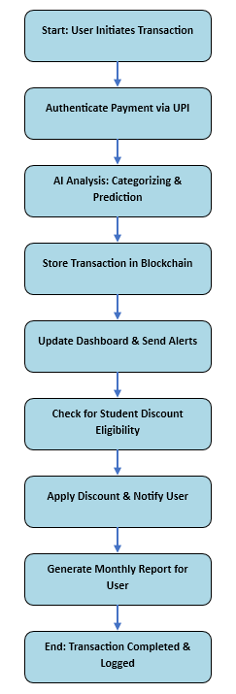
Technology Stack
Frontend: React Native (cross-platform app).
Backend: Node.js, Firebase (real-time DB).
AI/ML: TensorFlow (predictive analytics).
Security: Blockchain (Hyperledger), Biometric Auth.

Slide 13
06
Features

Slide 14
Features
1. AI-Powered Tracking: Visual graphs, spending categories (good/bad).
2. Student Discounts: Token system + ID verification for partner outlets.
3. Security: Biometric, PIN, blockchain-encrypted logs.
4. Prebooking: Reserve meals/stationary in advance.
5. Predictive Alerts: Monthly budget forecasts + overspending notifications.
6. Push Notification (Net Balance with cheesy lines)
7. Alert before useless expenditure if a useful one is already planned.
8. Share your analytical report on social media and download xml file for that report.
9. Introduce reward points for staying within budget or achieving savings goals.
10. Include badges and levels to keep users motivated.
11. Personalized spending insights and savings tips based on user behavior.
12. Partnership with digital wallets or banks for seamless money transfers and bill payments.

Slide 15
07
Challenges & Learnings

Slide 16
Challenges & Learnings
Challenges:
- Integrating AI with real-time UPI data.
- Balancing security (blockchain) with app speed.
Solutions:
- Used lightweight ML models + optimized APIs.
- Modular blockchain architecture.
Learnings:
- User simplicity > feature overload.

Slide 17
08
Future Scope & Next Steps

Slide 18
Future Scope & Next Steps
Scalability: Expand to young professionals.
Enhancements:
- Voice-based expense logging.
- Investment advisory via AI.
Monetization: Premium features + affiliate partnerships.
Provide information about ingredients and nutrition of already registered food outlets’ menu in the app.
Web version or browser extension for desktop access.

Slide 19
09
Conclusion & Thank You

Slide 20
Conclusion & Thank You
AI-powered expense tracker for students: smart budgeting, predictive alerts, and exclusive discounts. Secure, visual, and student-focused—revolutionizing financial wellness! PS:- Team Quantum

Slide 21
🎉 Thank You! 🎉

